Slide 1
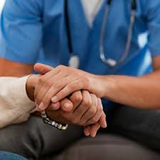
Urgent Care Response teams (UCRs)

Slide 2
UCRs across GM
You can now book into an Urgent community response (UCR) team in Bolton and Tameside and Glossop using the UEC button.
Below is a list of the UCRs across Greater Manchester and their contact details and operating hours:
Stockport 8am-10pm 7days a week 0161 204 4777
Trafford 8am-9.30pm 0300 3230303 (option 3)
Central Manchester 08:30am-8.30pm 0161 529 6220
South Manchester 08:30-8.30pm 0300 303 9650
North Manchester 08:30am-8.30pm 0161 667 3292
Salford 08:00-7.30pm 0161 206 6666
Bury 08:00-6.30pm 0161 253 6292 (accessible via UEC button)
Bolton 0800am-8pm 0161 763 8538
Wigan 08:00am-8pm 01942 481221
Tameside 08:00-6pm 0161 922 4257 (accessible via UEC button)
Oldham 08:00-6.30pm 0161 770 6771

Slide 3
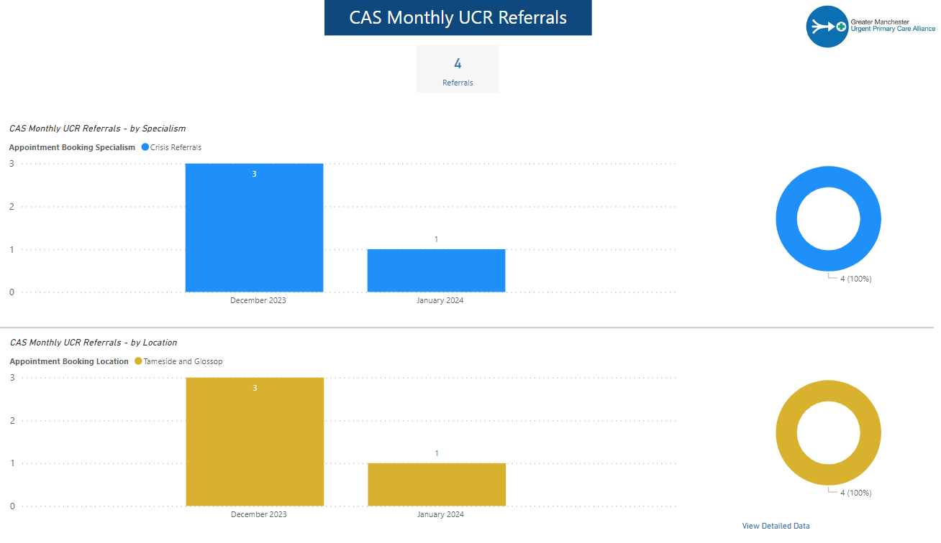
UCR referrals from CAS
10 referrals in last 2mths. We need to utilise this resource

Slide 4
Integrated Urgent Crisis Response Tameside & Glossop Integrated Care Foundation Trust
Peter Grace
Associate Director ITS & Clinical Lead
15 February 2024

Slide 5
Introduction
UCR (Urgent Community Response) is a dedicated crisis response team of Advanced Clinical Practitioners, Nurses, Therapists, Advanced Practitioners, Health Care Assistant and Admin who work with patients to prevent unnecessary admission to hospital by providing a rapid intervention delivered within two hours, in the p[patients own Home.

Slide 6
Our Team
1 Nurse Consultant
1 Trainee Advanced Clinical Practitioner
3 Advanced Clinical Practitioners
2 Enhanced Clinical Practitioners
Physiotherapists
Registered Nurses
Occupational Therapist
Assistant Practitioners

Slide 7
Criteria
REFERRAL INFORMATION:
UCR can accept HCP referrals, this service can support patients that require medical stabilisation in the community, triage category 3 and 4.
This is a team of Advanced Clinical Practitioners and paramedics who undertake investigations and diagnostics, can prescribe medication and initiate wrap around services to keep patients safe at home.
INCLUSIONS:
• Patients in a crisis with an urgent/acute medical/therapy/palliation need and a need to stay safely at home and avoid admission to hospital
EXCLUSIONS:
Under 18 years
RTC,
Intoxicated, Mental health
Anyone needing IV Fluids
Seizures
Cardiac sounding chest pain
History of LOC
NEWS greater than 5
Red refusal to go to hospital either with or without capacity
Operational Hours
Monday 08:00to-20:00
Tuesday 08:00to-20:00
Wednesday 08:00to-20:00
Thursday 08:00to-20:00
Friday 08:00to-20:00
Saturday 08:00to-20:00
Sunday 08:00to-20:00
Public Holiday 08:00to-20:00
Last referral is 18:00 hours
How To Refer
Electronically Via Adastra
Or contact Direct on:
07795151985 Medical / Clinical Cases.
0161 922 4888 option 1 for therapy or ASC

Slide 8
Pathways
Patient Identified
Specialist Referral
Falls
REFERRAL SOURCES VIA DIGITAL HEALTH HUB
Decompensation of frailty
111
Long Term Conditions service
Reduced functioning / Mobility
Single Point of Access
GP
Palliative EOL
Care Homes
Urgent Equipment
NWAS
Confusion Delirium
Virtual wards
Urgent Catheter Care
ED
Diabetes
Community Teams
Specialist Referral
TMBC Community Response Service
Carer Break down
SOB, UTI, House Bound,
Social Care

Slide 9
Patient Presentations
CLINICAL CASES
Age 85: years
Gender: female
Referred From: 111 DH
Presenting complaint: UTI symptoms for 1/52 unable to see GP.
PMH: HTN, COPD, C/A Lung, & LBBB
IMP: Decompensating Frailty, UTI
Plan: PX Nitro, red flag advice to family, Pendant alarm in property,
C&S Urine sent, GP To Review results .
Age: 81 Years
Gender: Female
Referred From: 111 DH
Presenting complaint: Swollen left Hand, without oedema, nil Injury
PMH: TIA, NOF, Anaemia, COPD
Plan: Increase dose of Hydroxychloroquine 300mg for 28 days help reduce inflammatory arthritis, bloods sent, GP updated to review results.
Age: 81 Years
Gender: Male
Referred From: 111 DH
Presenting complaint: Increased SOB, flushed, Mild confusion, increased effort of breathing reduced mobility, cellulitic calf hot to touch NEWS 5
PMH: Enlarged prostrate, MI, Hyperlipidaemia
Plan: PX Doxycycline, referred to VW, Bloods & sputum samples sent to lab, red flag advice given.

Slide 10
Performance
Direct referrals from 111 this month have only been 2.
111 from Digital Health LCAS have been 11
Lots of Opportunities !

Slide 11
Thank you
ANY QUESTIONS

Slide 12
Urgent Community Response and Virtual Ward
We offer a 2-hr urgent response for patients at risk of ED attendance in the next 24hrs providing clinical, therapy and social intervention for 72hrs.
Referrals taken from all community service
The VW provides hospital at home intervention, with the option of tech enabled care.
Tameside Digihealth Team providing this remote monitoring
Step up
Step down
Notes:
18% pts referred to ICS and self referrals if had intervention previously

Slide 13
UCR and VW collaboration
We are a team of
Extensivist GP’s,
ACPs
SNR RNs
Therapists
Social Workers
pharmacy support
SSW
Therapy Assistants
Notes:
NMP everyday and, all RN ACA skills, all team compliant with NEWS2 and sepsis screening

Slide 14
How do you contact us?
Referral via SPoA 204-4777
UCR Referrals accepted 08:00 – 20:00hrs
VW 08:00- 18:00hrs
Service Delivery 08:00 -22:00hrs
Accept referrals > 18 yrs, with a Stockport GP, exclude pregnancy related, mental health issue and predominant problem drug/alcohol abuse
Patients will be assessed within 2 hours
Notes:
Take the demographics – transfer the referrer to UCR NMP on everyday clinical coordinator and escalation clinician

Slide 15
What can we offer?
Work collaboratively with T&G digital platform
Urgent response for senior clinical assessment within 2hours
Multi professional inc SW
Digital monitoring if required - Docobo
Strong liaison with community services
Designated pathways for referral into UCR/VW and on discharge
Care home pilot

Slide 16
Pathways
Respiratory
Heart Failure
Frailty, encompasses palliative and EoL care
Next steps
Implement a post op # NoF- hypotension pathway
Post Natal Hypertension
UTI step down
MAUR step up
Scoping surgical pathways
Notes:
& onward referrals to neighbourhood ANP and GP informed of the intervention and the patient was aware she could self refer to the team in the

Slide 17
What are our opportunities to work together?
Optimise 111 referrals with Adastra
IV services collaboration
Therapy and SSW intervention
Digihealth monitoring

Slide 18
Case study
• 38 year old female. 8 months post natal.
• AE attendance with abdo pain, nausea and jaundice-short stay admission.
• Grossly deranged LFTs, Ultrasound- biliary tree dilation.
• Wanted to be at home as breastfeeding and a young family.
• DOCOBO delivered with BD observations/tel call support.
• Alternate days LFT’s and infective markers liaised with gastro team.
• LFT’s improved gradually after an initial lag.
• MRCP performed whilst on VW- Gallstones in common bile duct.
• ERCP then booked for the following week and she was discharged from VW.
• Best place of care for a young mum, aware when to seek help. Reassured by daily observations and regular blood monitoring. Positive patient feedback.

Slide 19
THANK YOU
ANY QUESTIONS?
Jayne Etches Operational Lead UCR and VW
jayne.etches@stockport.nhs.uk
07810 816214
Expert Adviser for the NICE Centre for Guidelines

Slide 20
2Hr UCR/ Rapid Response/ Hospital at Home
Suzanne Goggins – Consultant Practitioner.

Slide 21
What do we do ??
2 Hr UCR/ Rapid Response/ Hospital @ Home provides personalised care and choice for patients, by combining face-to-face care from multi-disciplinary teams based in the community and may include remote monitoring using apps, technology platforms, wearables, and medical devices such as pulse oximeters allowing hospital-level care. This service offer can provide an alternative to admission or facilitate earlier discharge from hospital including equipment provisions in urgent circumstances to prevent hospital admission, therapy and environmental assessments, provide social care support and assessments. We have available 12-lead ECGs, Urgent bloods back within an hour, Bladder Scanners, X-Rays/CT Scans, we have close links with FGH Frailty SDEC/ NWAS/ GPs.
Admission avoidance - to support people who experience an acute medical episode, at home (usual place of residence i.e., care home or community bed) if their needs can be safely met within the community without requiring a hospital admission.
Transfer of Care/ Early Discharge - To include referrals from people attending the Emergency Department and SDEC (Same day emergency care) and to support to facilitate an earlier discharge from hospital wards.

Slide 22
Available in the Service / Our Team
The 2Hr UCR/ Rapid Response/ Hospital @ Home service brings together a range of professions and skills to manage patients with acute medical needs,/social care needs within the patient’s own home or main residence. The multi-disciplinary team comprises of the following staff:
Hospital Consultants
H@H GP
Register Manager
Assistant Manager
Consultant Practitioner
Advanced Practitioner
Advanced Clinical Practitioner
Nurses (Days)
Nurses (Days)
Occupation Therapists
Physiotherapist
Social Workers
Social Care Officers
Pharmacists/ Pharmacist Tech
Support Workers (Day)
Support Workers (Night)
Administration Team

Slide 23
Inclusion/Exclusion criteria
Inclusion:
Only applicable to individuals over the age of 18 and pay their council tax to Bury Council.
Family/ carer breakdown, patient refusing to go to hospital, requires urgent equipment to avoid hospital admission.
Requires remote monitoring of observations – Doccla.
Are admitted or due to be admitted with a primary diagnosis which has been deemed appropriate for care under the pathways of 2Hr UCR/ Rapid Response/ Hospital @ Home.
Are clinically improving or stable enough to be managed at home (with or without remote monitoring of vital signs as required and robust telemedicine support).
Meet the individual criteria outlined for each primary diagnosis condition in the approved pathways – IV Fluids, Home IV, Catheter, Cardiology, Palliative and End of Life (EOL).
The admitting responsible clinician has agreed the patient is suitable for ongoing admission under Hospital at Home (and has agreed clear parameters/monitoring requirements).
Patient consented.
Do not meet any of the absolute exclusion criteria outlined.
Falls – long lies without significant injury.
Exclusion:
Individuals under the age of 18.
Acutely deteriorating/haemodynamic instability.
Social circumstance or cognition such that meaning patient would be unsafe at home despite the support offered by the 2Hr UCR/ Rapid Response/ Hospital @ Home.
Pregnant women/ 6 weeks postpartum.
Acute Mental Health crisis.
Trauma (initial presentation – could be step down post.).
Suspected Sepsis.
Residents who pay their council tax to another locality despite being registered with Bury GP.

Slide 24
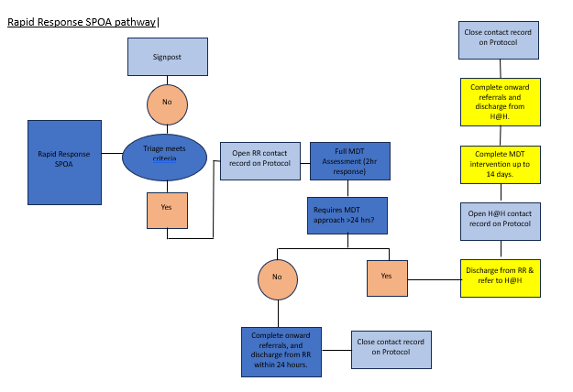
Single Point of Access (SPoA) for all services
0161 253 6292

Slide 25
The below table describes the Hospital at Home Pathways including criteria and how the H@H differentiate from the Rapid Response offer:

Slide 26
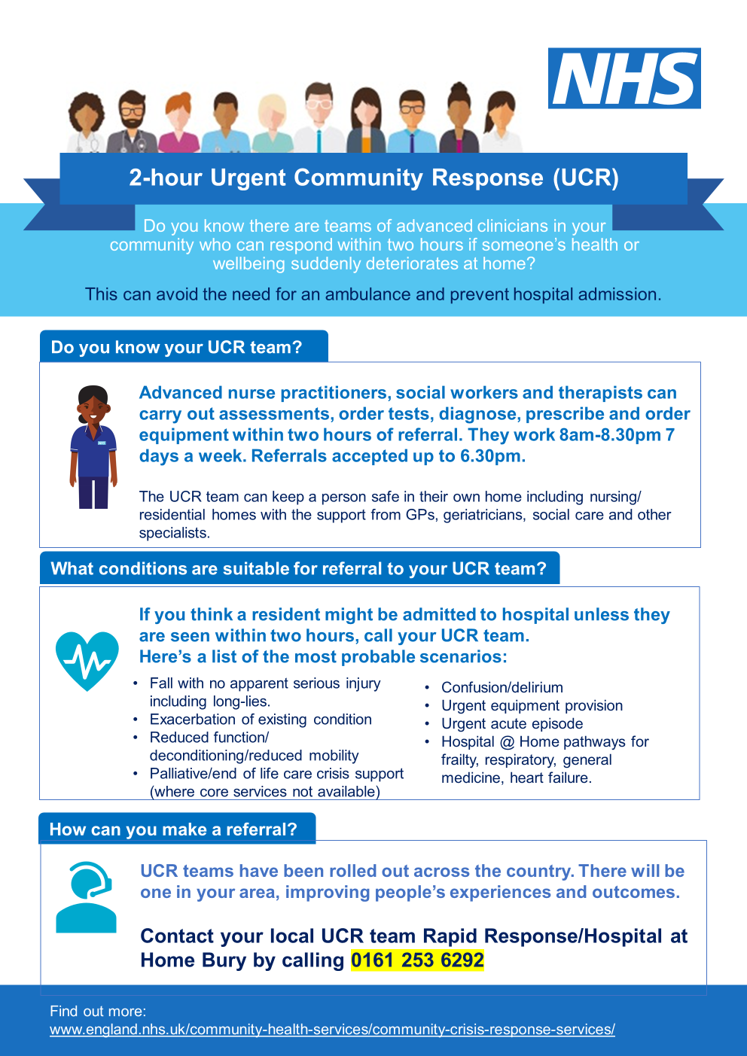
If there is anything to take away from today’s presentation, please print this 2 Hr UCR poster and put in every office, staff room and waiting area.

Slide 27
Summary
2 Hr UCR/ Rapid Response/ Hospital @ Home sit under one team and one SPoA contact number, we provide a full MDT assessment and provide a wraparound service to the residents of Bury, this can be up to 72 hours under 2Hr UCR/Rapid response or up to 14 days under our Hospital @ Home service.
‘IF IN DOUBT THEN PLEASE PICK UP THE PHONE AND DISCUSS WITH OUR TRIAGE CO-ORDINATOR – 0161 253 6292’

Slide 28
Thank You
Suzanne Goggins – Consultant Practitioner
Email address – s.goggins@bury.gov.uk
Website address

